Slide 1
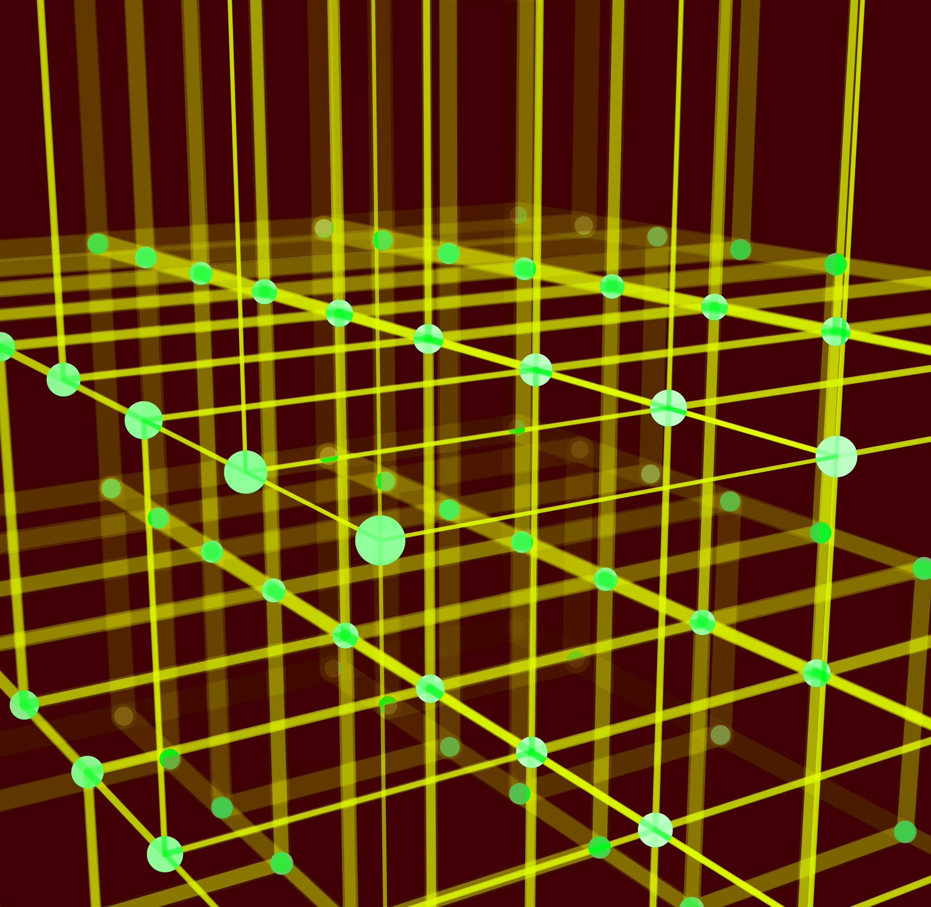
Distributed Aggregation on Various Network Structures
Alessandro Castellucci
Distributed Artificial Intelligence Project

Slide 2
What is Distributed Aggregation? (1)
Given a network of nodes/processes there is an aggregation function AF that can be calculated in a distributed way from the states s of the processes and the environmental variables e observed by them (if present):
AF(f(s1,e1), … ,f(sn,en)) where f can be locally computed by each node/process.
AF can be MAX, MIN, AVG, STD, COUNT, etc.
Distributed aggregation enables the evaluation of aggregated perspectives on the system state

Slide 3
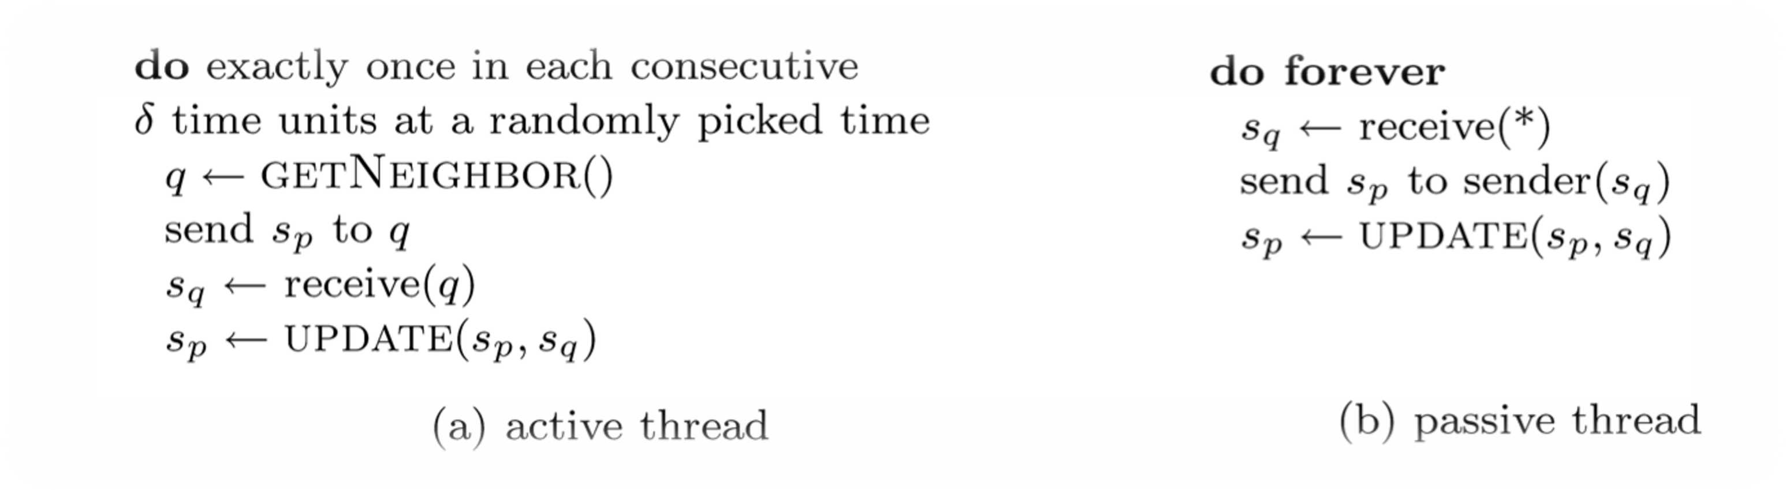

What is Distributed Aggregation? (2)
Key idea: GOSSIPING between neighbors.
From consensus theory: it’s impossible to reach consensus in case of failures, and even if one only wants to tolerate a single failure of any nature.
So, if we have an unreliable system, we obtain an approximated final value, and the goodness of that value depends on the network structure and on which nodes and/or links failed

Slide 4
Network structure and convergence
Aggregation algorithms work well if the computation of the aggregated values propagate in the whole network: i.e., if the “gossip” propagates
Networks with low percolation threshold and characteristic path length (i.e., small degree of separation) converge very quickly
Small World, Scale-free and Random networks converge very quickly and are robust with respect to node failures

Slide 5
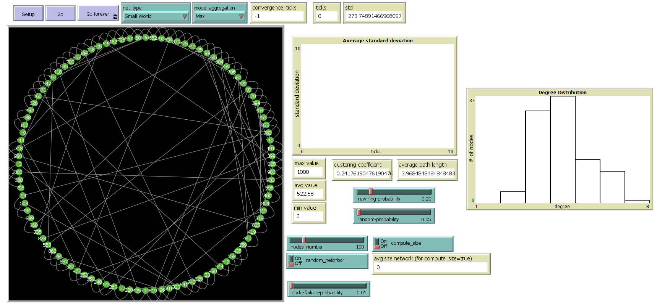
NetLogo Simulation Overview

Slide 6
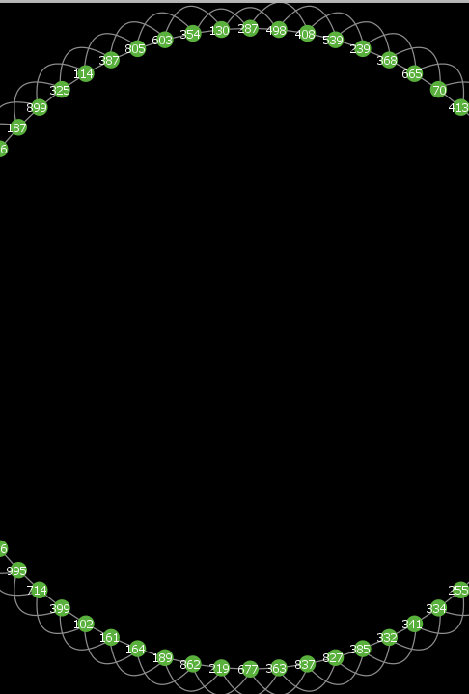


Lattice Network
4-regular 2D network
Good clustering factor
High percolation threshold and characteristic path length
Some Experiments
Nodes | Aggregation | Convergence ticks | Random neighbor
300 | MAX | 5 900 ca | No
300 | MAX | 23 000 ca | Yes
300 | MIN | 6 200 ca | No
300 | MIN | 19 000 ca | Yes
300 | AVG | 750 000 ca | No
300 | AVG | 3 200 000 ca | Yes

Slide 7
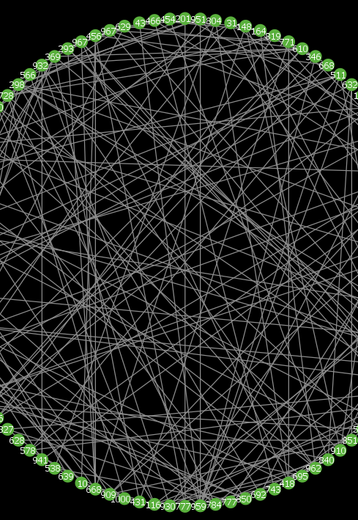
Random Network
Erdos-Renyi network: each possible link is given a fixed probability of being created (random link probability)
Bad clustering factor
Low percolation threshold and characteristic path length
Some Experiments
Nodes | Aggregation | Convergence ticks | Random Link Probability | Random neighbor
300 | MAX | 580 ca | 3% | No
300 | MAX | 2 100 ca | 3% | Yes
300 | MIN | 600 ca | 3% | No
300 | MIN | 2 600 ca | 3% | Yes
300 | AVG | 1 700 ca | 3% | No
300 | AVG | 8 600 ca | 3% | Yes

Slide 8
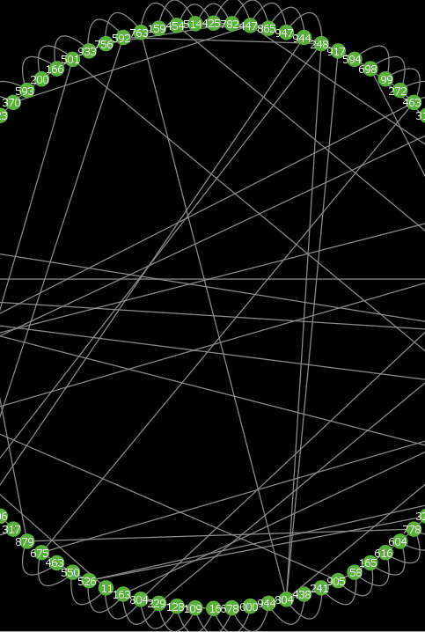
Small World Network
Watts & Strogatz model: from lattice starts random re-wiring (re-wiring probability)
Good clustering factor
Low percolation threshold and characteristic path length
Not scale-free as real social networks
Some Experiments
Nodes | Aggregation | Convergence ticks | Re-wiring Probability | Random neighbor
300 | MAX | 1 000 ca | 20% | No
300 | MAX | 3 000 ca | 20% | Yes
300 | MIN | 1 200 ca | 20% | No
300 | MIN | 3 700 ca | 20% | Yes
300 | AVG | 9 600 ca | 20% | No
300 | AVG | 47 000 ca | 20% | Yes

Slide 9
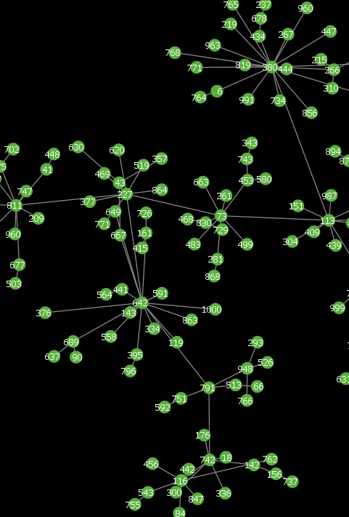
Scale-free Network
Barabási model: preferential attachment
Scale-free as real social networks (Power law)
Bad clustering factor
Low percolation threshold and characteristic path length
Some Experiments
Nodes | Aggregation | Convergence ticks | Random neighbor
300 | MAX | 2 500 ca | No
300 | MAX | 9 300 ca | Yes
300 | MIN | 2 300 ca | No
300 | MIN | 9 400 ca | Yes
300 | AVG | 200 000 ca | No
300 | AVG | 2 000 000 ca | Yes
We need large number of nodes to see Scale-free network potential

Slide 10
Considerations
Performances results also depend on nodes number and probability parameters
Lattice network is obviously the worst
Small World and Scale-free networks obtain good results
Random network outperforms all other networks in all operations in this simulation
Although outperformed by Random network, Small World and Scale-free networks reach a good approximation value very quickly

Slide 11
Node Failures
Nodes | Network type | Aggregation | Node failure probability | Behaviour
300 | Lattice | MAX | 1% | Not immediate adequate approximation value
300 | Random | MAX | 1% | Very good and fast approximation value: robust
300 | Small World | MAX | 1% | Very good and fast approximation value: robust
300 | Scale-free | MAX | 1% | Very good and fast approximation value: robust (depends on which node fails)
Performances also depends on failure rate parameter

Slide 12
Bibliography
Professor F. Zambonelli’s slides and NetLogo simulations
NetLogo Models Library

